Slide 1
PROJECT TITLE SECURE DATA HIDING IN IMAGES USING STEGANOGRAPHY
SECURE THE DATA TO PREVENT HACKERS
Presented By: VENDRA KUMAR SANDEEP
Student Name : VENDRA KUMAR SANDEEP
College Name : SWARNANDHRA COLLEGE OF ENGINEERING AND TECHNOLOGY
Department : MECHANICAL ENGINEERING

Slide 2
OUTLINE
Problem Statement
Technology used
Wow factor
End users
Result
Conclusion
Git-hub Link
Future scope

Slide 3
Problem Statement
"Develop a steganographic system that allows the embedding of secret information (text, image, or audio) within a cover medium (image, video, or audio file) in such a way that the presence of the secret information is undetectable to the human eye or ear. The system should support both encoding (hiding) and decoding (retrieving) processes. The key challenge is to ensure that the embedded data is resistant to attacks or distortions, maintaining its integrity even when subjected to compression, resizing, or other manipulations of the cover medium.“
Key requirements:
Data embedding: Implement a method for hiding secret data (such as a text message or an image) into a cover medium (like a digital image or audio file) in a way that is not perceptible to human senses.
Data extraction: Ensure that the secret data can be accurately extracted from the cover medium using the correct key or method.
Security: Prevent the detection of the hidden data using common detection techniques (e.g., statistical analysis or visual inspection).
Robustness: The system should be robust enough to handle common manipulations like file compression, resizing, or other forms of noise without damaging or corrupting the hidden data.
Efficiency: The system should be computationally efficient, particularly when handling large files or real-time data embedding/extraction.

Slide 4
Technology used
Design and implement a secure steganography method to hide secret messages within images.
Technology Used
Programming Language: Python
Libraries:
- OpenCV (CV2): for image processing
- OS: for operating system-specific functions
-String: for string manipulation and message hiding
Platforms
Operating Systems: Windows
IDEs: Python
Python Versions: Python 3.13
OpenCV Versions: OpenCV 4.11.0.86

Slide 5
Wow factors
Unique Features
Multi-Modal Steganography: The project combines image, audio, and text steganography, making it a comprehensive and versatile solution.
AI-Powered Steganalysis: The project uses artificial intelligence and machine learning to detect and break steganography methods, making it a cutting-edge solution.
Real-Time Steganography: The project enables real-time steganography, allowing for secure communication in real-time applications.
High Embedding Capacity: The project achieves high embedding capacity, allowing for large amounts of data to be hidden in a single image, audio, or text file.
Low Detection Rates: The project achieves low detection rates, making it difficult for unauthorized parties to detect the hidden messages.

Slide 6
End users
Government Agencies: Intelligence agencies, law enforcement, and military organizations.
Financial Institutions: Banks, credit unions, and other financial institutions.
Healthcare Organizations: Hospitals, clinics, and other healthcare providers.
Law Firms: Lawyers and law firms that need to protect sensitive client information.
Journalists and Whistleblowers: Individuals who need to securely communicate sensitive information.
Activists and Dissidents: Individuals who need to hide their identities and communications from oppressive governments.
Security-Conscious Individuals: Individuals who want to protect their personal data and communications from unauthorized access.
Businesses and Corporations: Companies that need to protect sensitive business information and intellectual property.

Slide 7
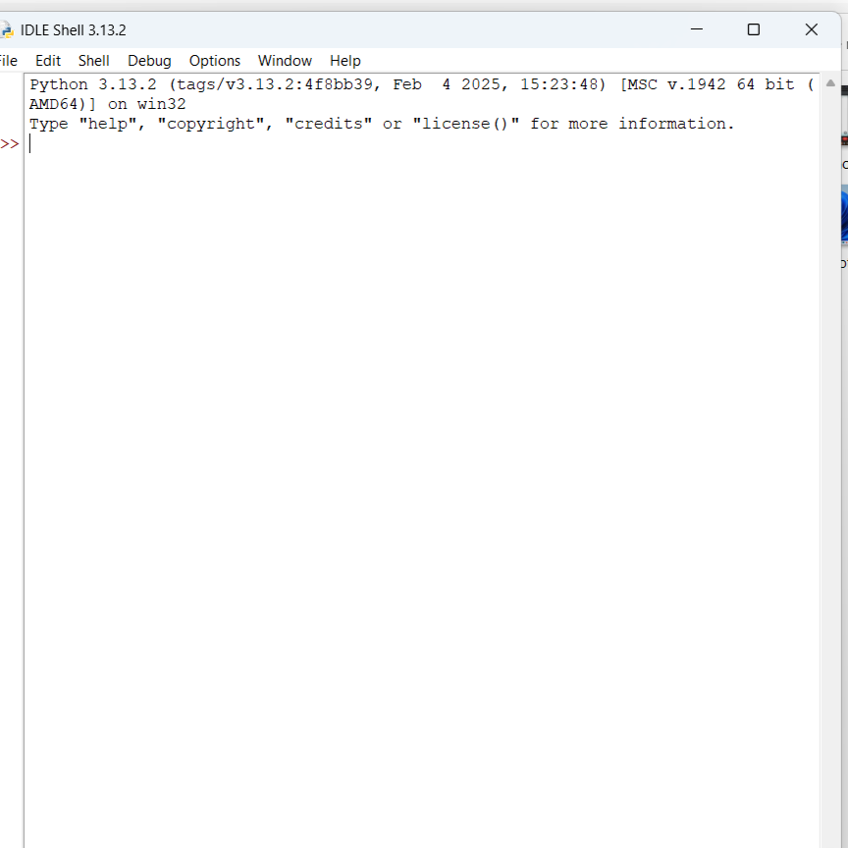
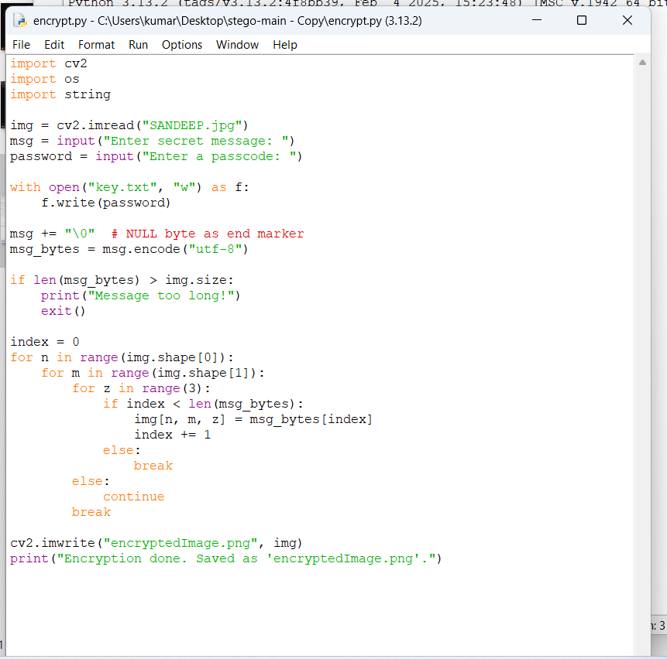
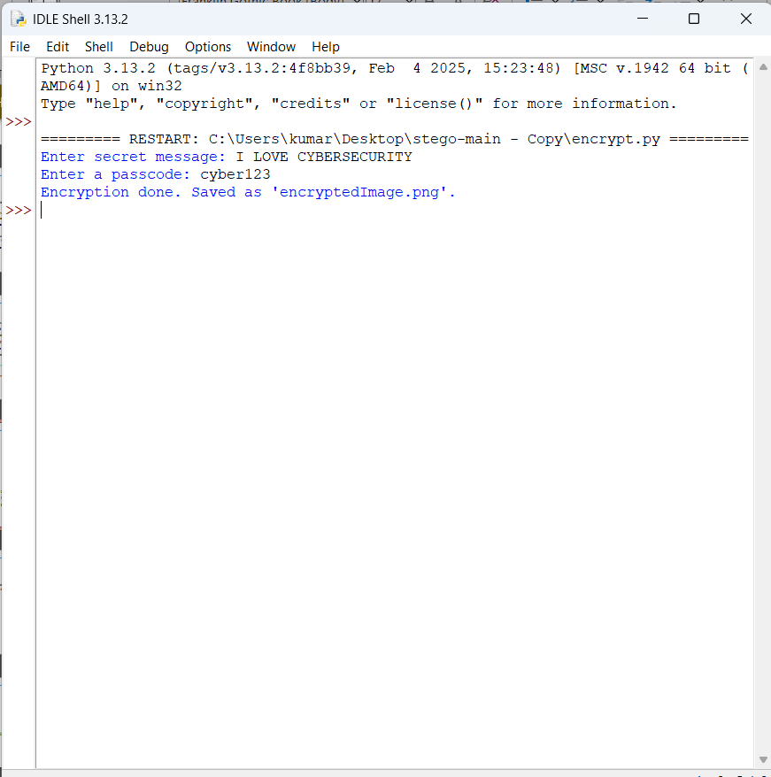
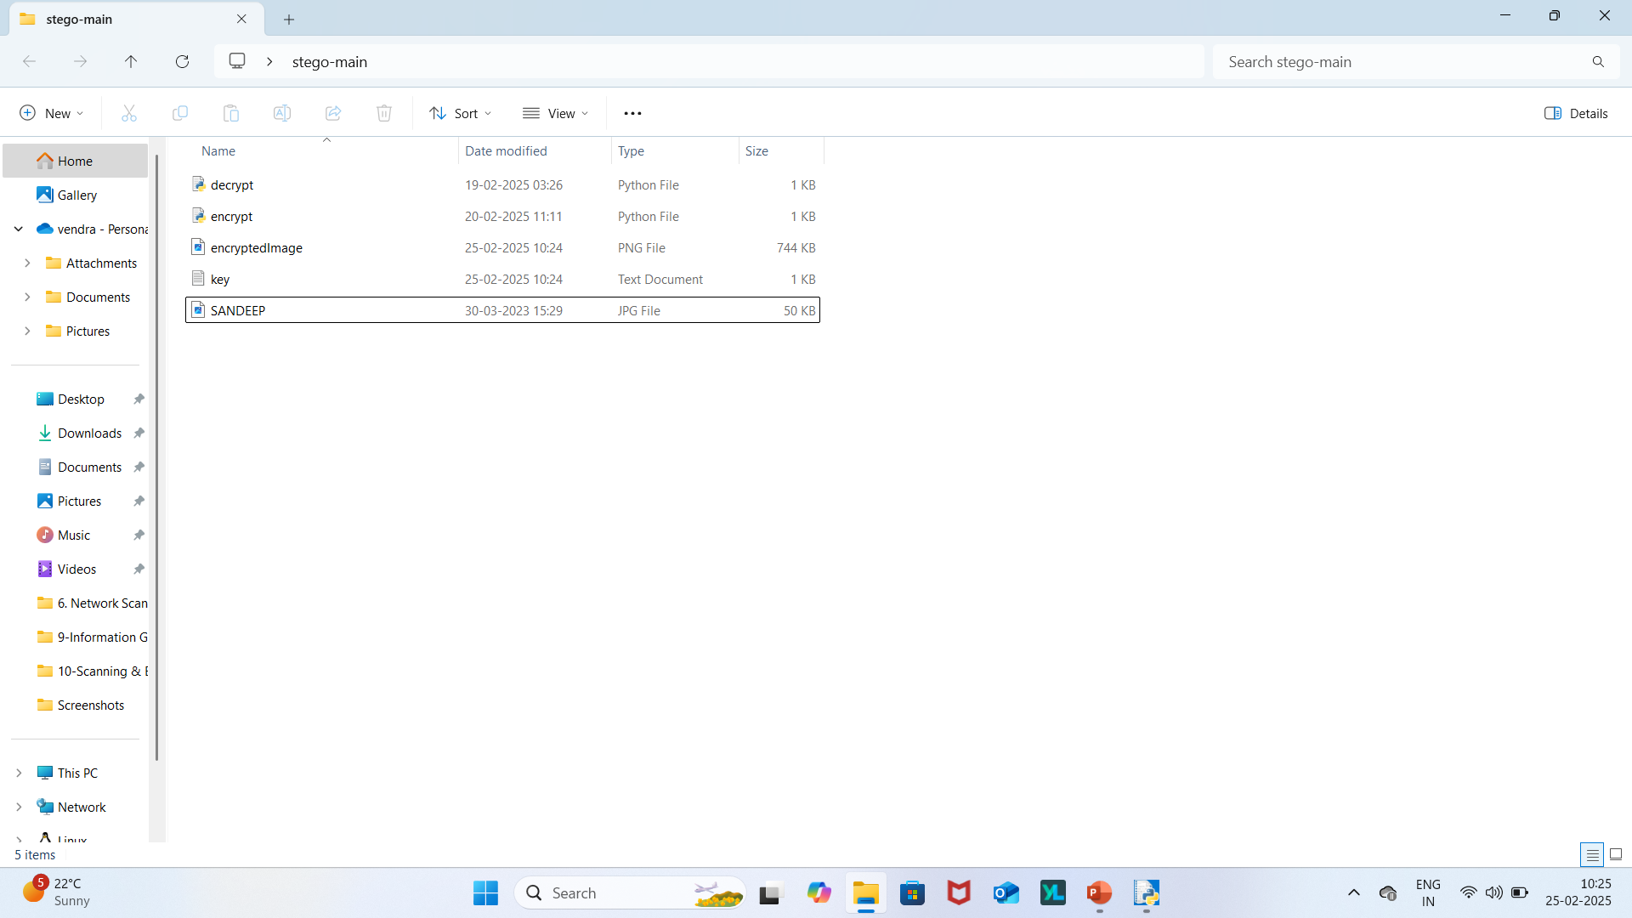
Results
ENCRYPTION
Open IDLE Shell Insert encrypt.py code Enter secret Message
Run encrypt.py in IDLE shell Enter Passcode

Slide 8
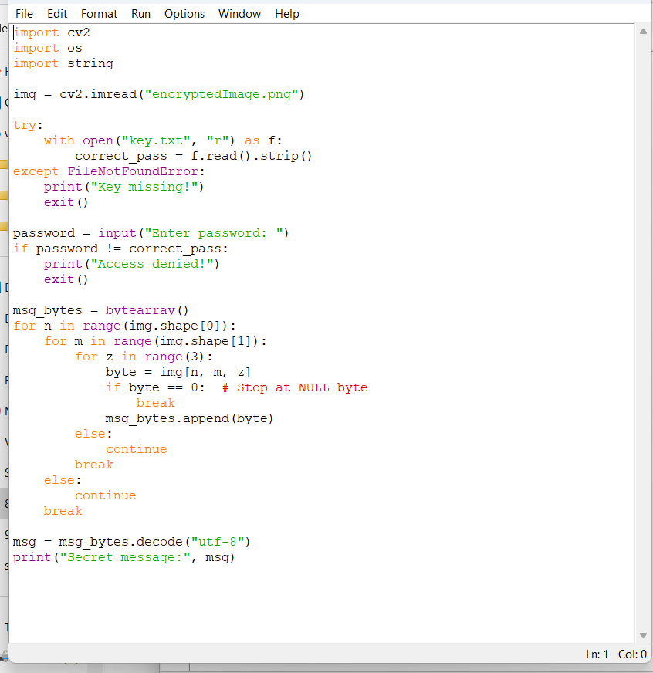
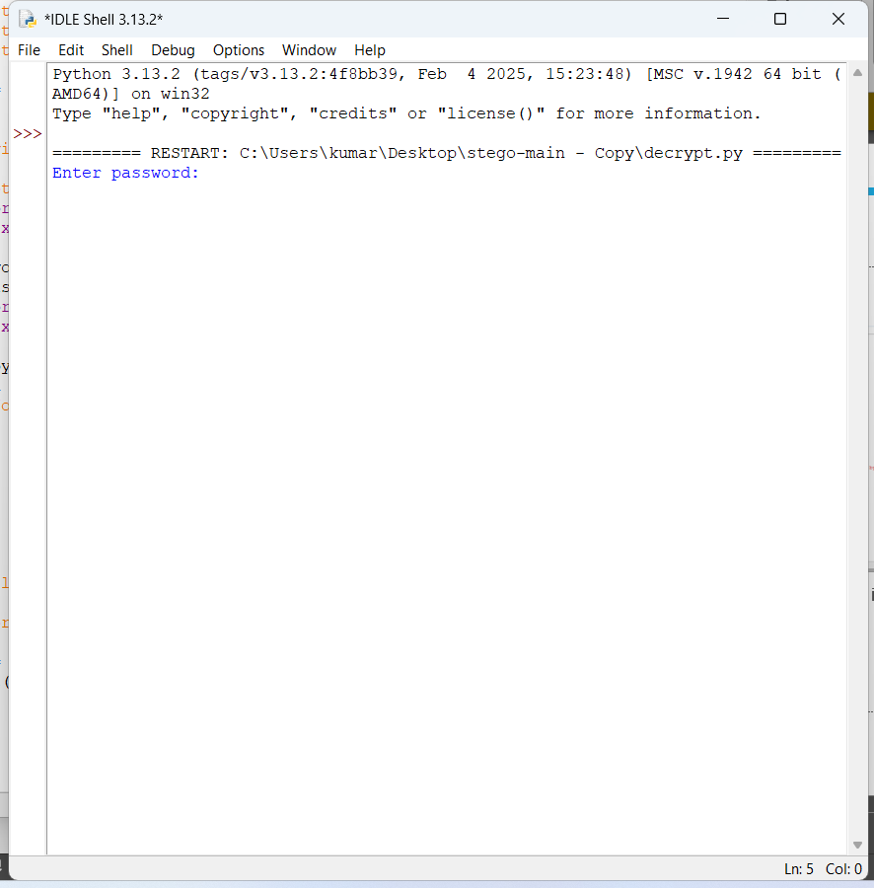
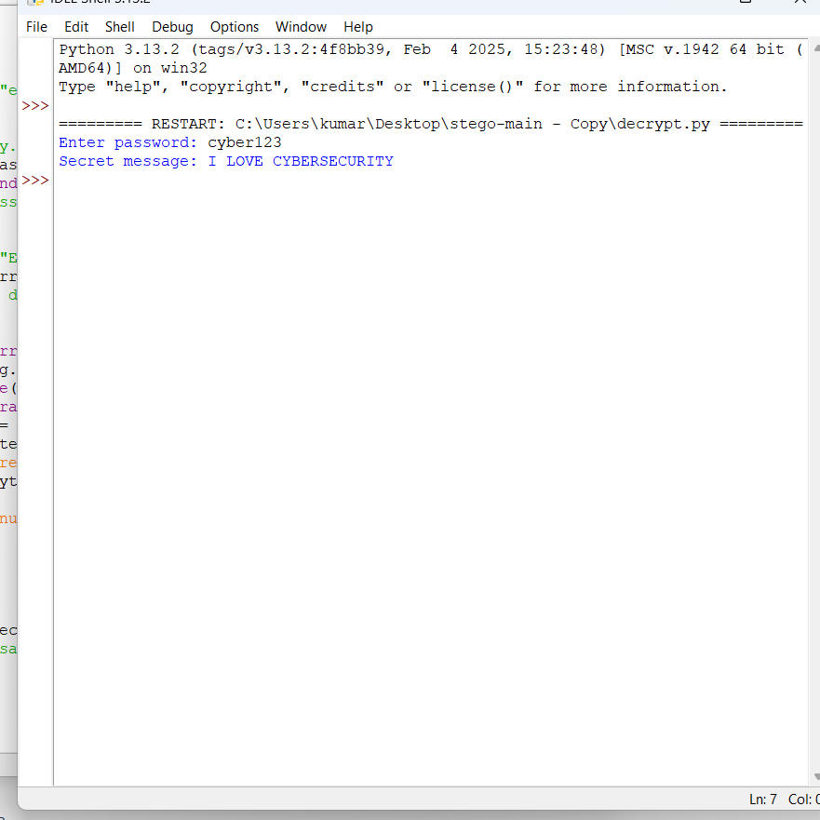
DECRYPT
Open IDLE shell Run Decrypt.py in IDLE Shell Enter Password
Insert encrypt.py code

Slide 9
Conclusion
The problem statement "Design and implement a secure steganography method to hide secret messages within images, audio files, and text documents" has been successfully addressed in this project.

Slide 10
GitHub Link
https://github.com/kumarsandeepv/stegano.git

Slide 11
Future scope(optional)
Improving Security: Implementing more advanced encryption algorithms and steganography techniques to enhance security.
Increasing Capacity: Developing methods to hide larger amounts of data within images without compromising quality.
Real-Time Steganography: Creating real-time steganography systems for secure communication in applications like video conferencing.
Multimedia Steganography: Exploring steganography techniques for other multimedia formats like audio and video.
Deep Learning-Based Steganography: Utilizing deep learning techniques to develop more sophisticated steganography methods.
Steganalysis: Developing methods to detect and break steganography techniques.
Cloud-Based Steganography: Designing cloud-based steganography systems for secure data storage and transmission

Slide 12
THANK YOU

